Slide 1
Relations and Functions
CMSC250

Slide 2
Relations

Slide 3
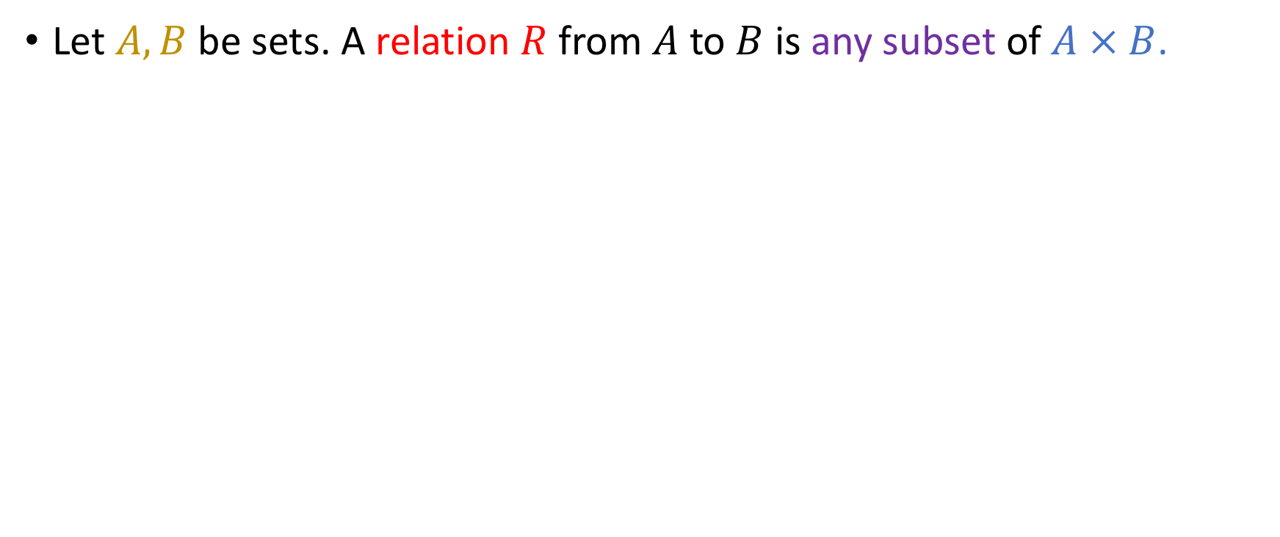
Definition
Let $A, B$ be sets. A relation $R$ from $A$ to $B$ is any subset of $A × B$.

Slide 4
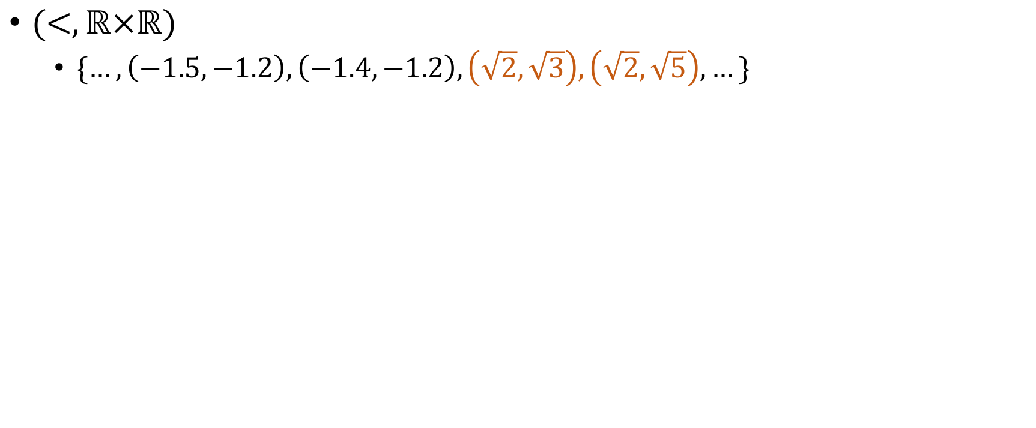
Examples
$(<, ℝ×ℝ)$
$\{…, \left(−1.5, −1.2\right), \left(−1.4,−1.2\right), \left(\sqrt{2}, \sqrt{3}\right), \left(\sqrt{2}, \sqrt{5}\right),…\}$
Notes:
Verbally tell them that is is “less than” on R^2

Slide 5
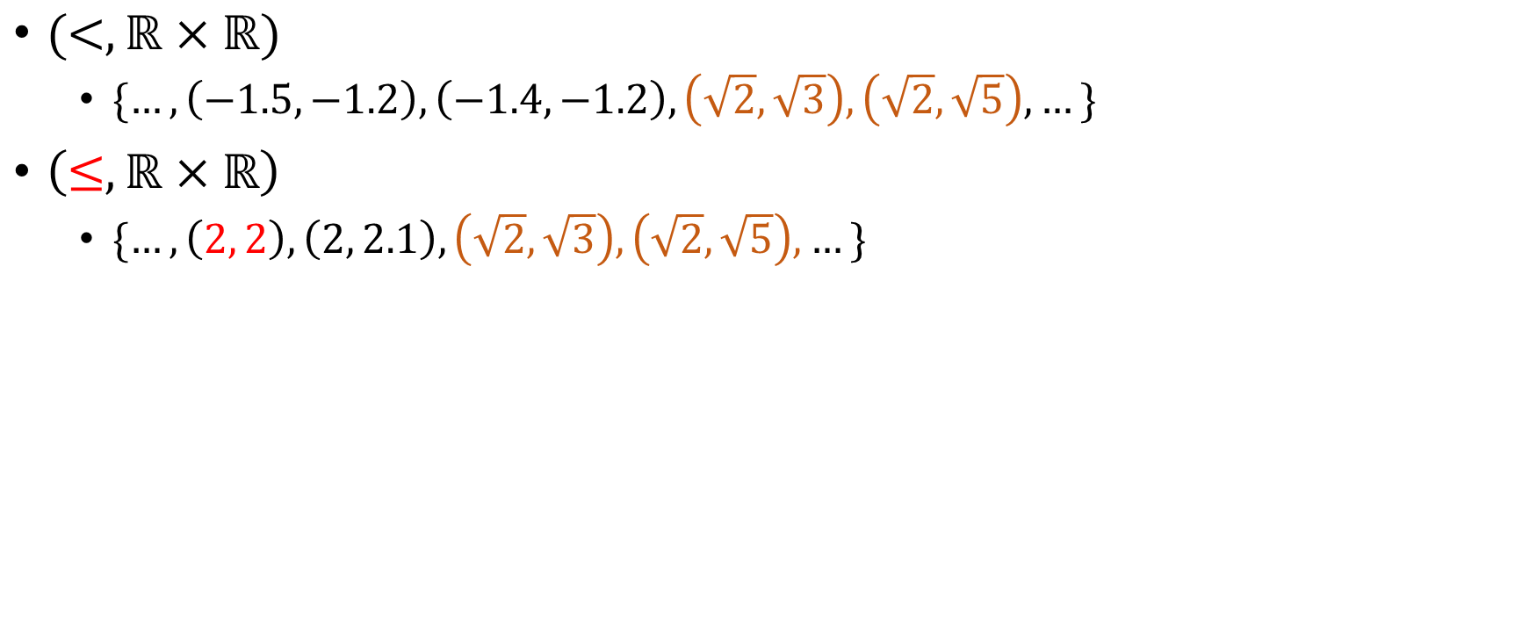
Examples
$(<, ℝ×ℝ)$
$\{…, \left(−1.5, −1.2\right), \left(−1.4,−1.2\right), \left(\sqrt{2}, \sqrt{3}\right), \left(\sqrt{2}, \sqrt{5}\right),…\}$
$\left(≤,ℝ×ℝ\right)$
$\{…, \left(2, 2\right), \left(2, 2.1\right),\left(\sqrt{2}, \sqrt{3}\right), \left(\sqrt{2}, \sqrt{5}\right),…\}$

Slide 6
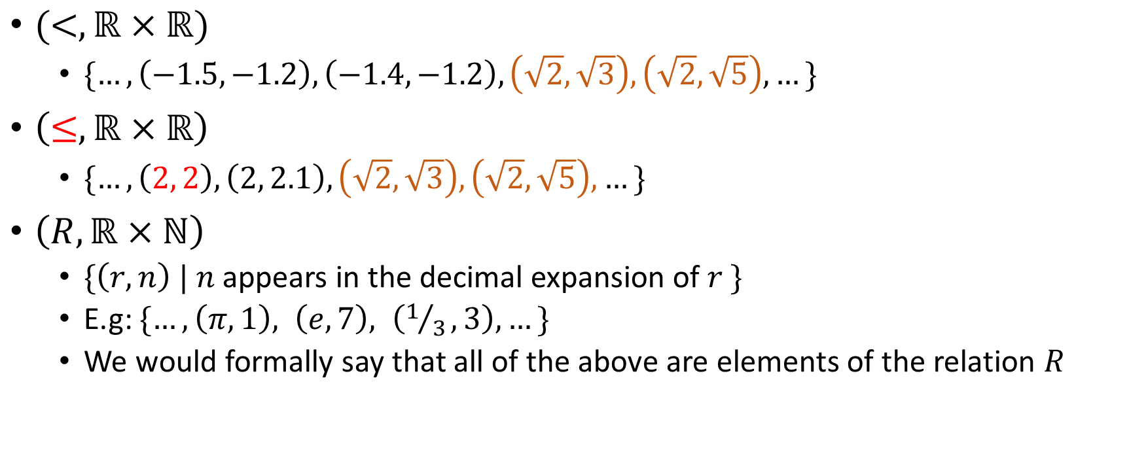
Examples
$(<, ℝ×ℝ)$
$\{…, \left(−1.5, −1.2\right), \left(−1.4,−1.2\right), \left(\sqrt{2}, \sqrt{3}\right), \left(\sqrt{2}, \sqrt{5}\right),…\}$
$\left(≤,ℝ×ℝ\right)$
$\{…, \left(2, 2\right), \left(2, 2.1\right),\left(\sqrt{2}, \sqrt{3}\right), \left(\sqrt{2}, \sqrt{5}\right),…\}$
$\left(R, ℝ×ℕ\right)$
$\{\left(r, n\right) | n$appears in the decimal expansion of $r \}$
E.g: $\{…, \left(π, 1\right), \left(e, 7\right), \left(1/3, 3\right), …\}$
We would formally say that all of the above are elements of the relation $R$
Notes:
Verbally state the names of the other relations.

Slide 7
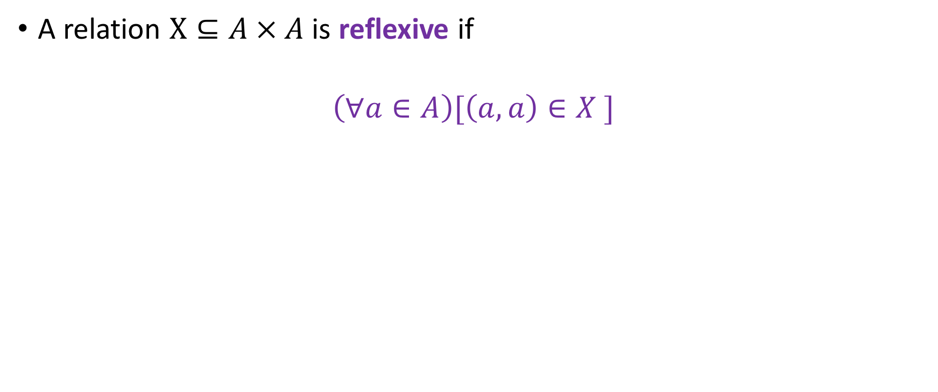
Reflexivity
A relation $X⊆A × A$ is reflexive if
$$\left(∀a∈A\right)[\left(a, a\right)∈X ]$$

Slide 8
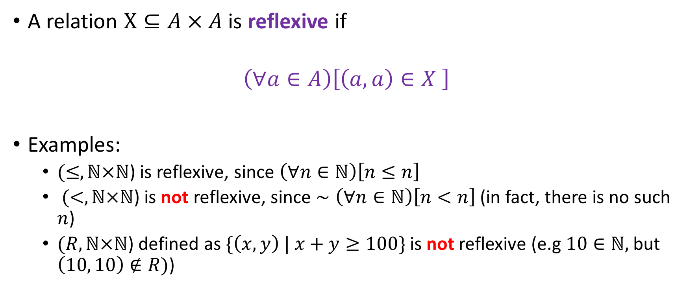
Reflexivity
A relation $X⊆A × A$ is reflexive if
$$\left(∀a∈A\right)\left[\left(a, a\right)∈X \right]$$
Examples:
$(≤,ℕ×ℕ$) is reflexive, since $\left(∀n∈ℕ\right)\left[n≤n\right]$
$(<,ℕ×ℕ$) is not reflexive, since $∼\left(∀n∈ℕ\right)\left[n<n\right]$ (in fact, there is no such $n$)
$(R,ℕ×ℕ$) defined as $\{\left(x, y\right) | x+y≥100\}$ is not reflexive (e.g $10∈ℕ,$but $\left(10, 10\right)∉R)$)
Notes:
Say verbally that one needs only one counter-example (a forall statement can be proven negative with just one witness)

Slide 9
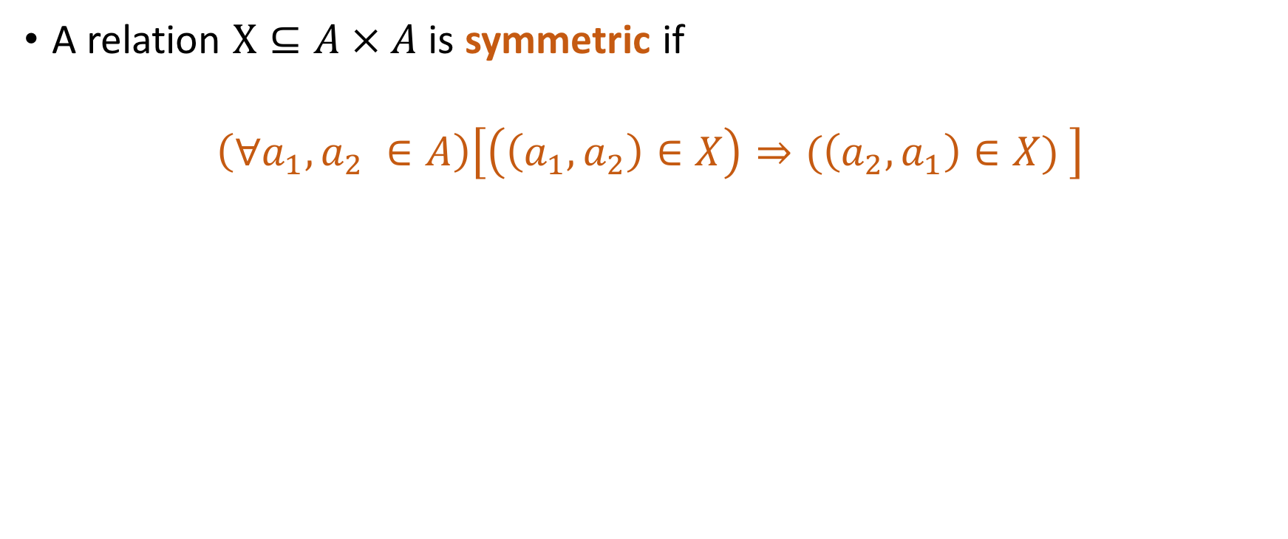
Symmetry
A relation $X⊆A × A$ is symmetric if
$$\left(∀a_{1},a_{2} ∈A\right)\left[\left(\left(a_{1}, a_{2}\right)∈X\right)⇒(\left(a_{2}, a_{1}\right)∈X) \right]$$

Slide 10
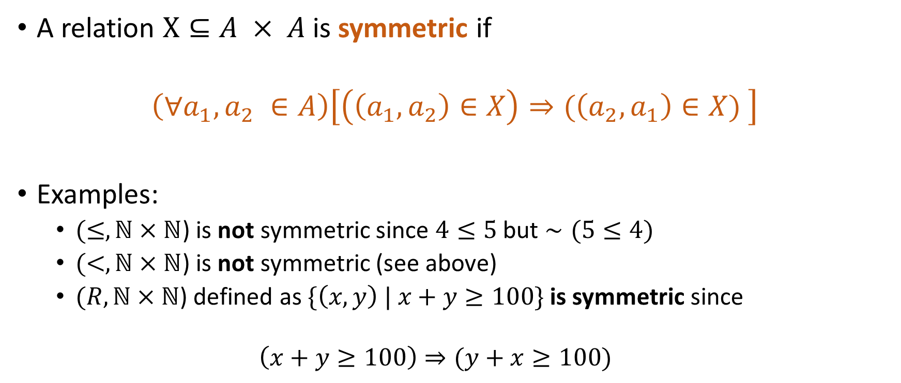
Symmetry
A relation $X⊆A × A$ is symmetric if
$$\left(∀a_{1},a_{2} ∈A\right)\left[\left(\left(a_{1}, a_{2}\right)∈X\right)⇒(\left(a_{2}, a_{1}\right)∈X) \right]$$
Examples:
$(≤,ℕ×ℕ$) is not symmetric since $4≤5$ but $∼(5≤4)$
$(<,ℕ×ℕ$) is not symmetric (see above)
$(R,ℕ×ℕ$) defined as $\{\left(x, y\right) | x+y≥100\}$ is symmetric since
$$\left(x+y≥100\right)⇒(y+x≥100)$$

Slide 11
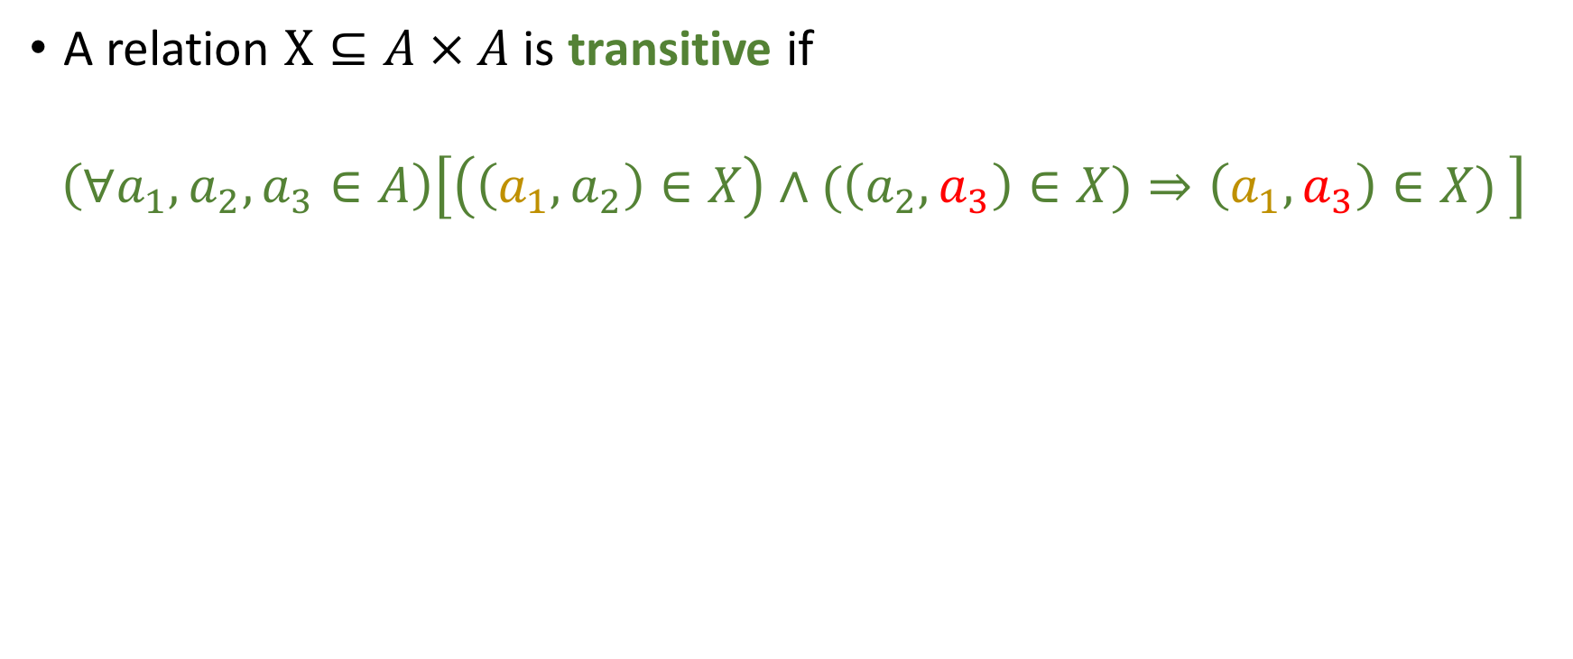
Transitivity
A relation $X⊆A × A$ is transitive if
$$\left(∀a_{1},a_{2}, a_{3}∈A\right)\left[\left(\left(a_{1}, a_{2}\right)∈X\right)∧(\left(a_{2},a_{3}\right)∈X)⇒\left(a_{1}, a_{3}\right)∈X) \right]$$

Slide 12
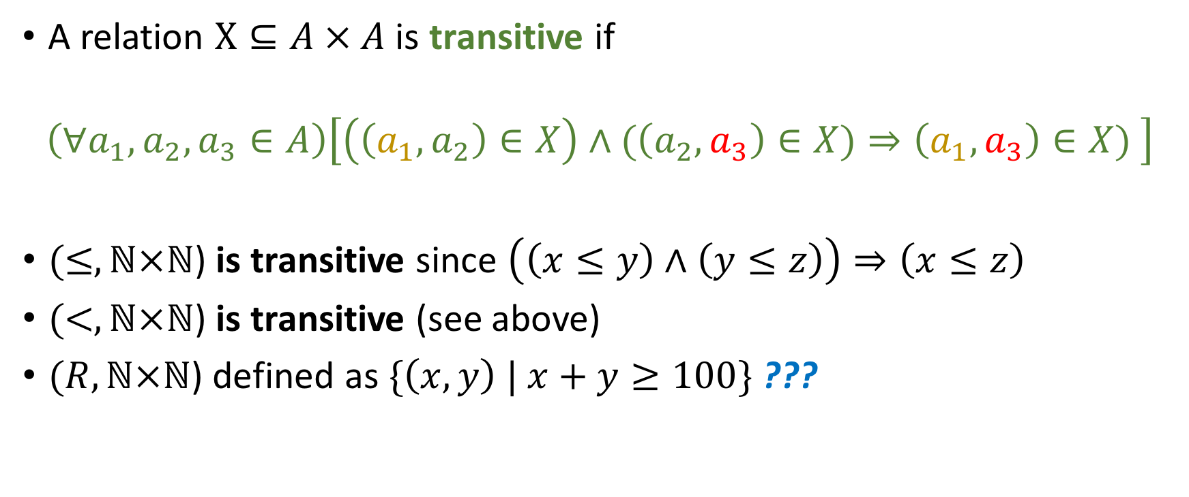
Transitivity
A relation $X⊆A × A$ is transitive if
$$\left(∀a_{1},a_{2}, a_{3}∈A\right)\left[\left(\left(a_{1}, a_{2}\right)∈X\right)∧(\left(a_{2},a_{3}\right)∈X)⇒\left(a_{1}, a_{3}\right)∈X) \right]$$
$(≤,ℕ×ℕ$) is transitive since $\left(\left(x≤y\right)∧\left(y≤z\right)\right)⇒\left(x≤z\right)$
$(<,ℕ×ℕ$) is transitive (see above)
$(R,ℕ×ℕ$) defined as $\{\left(x, y\right) | x+y≥100\}$ ???

Slide 13
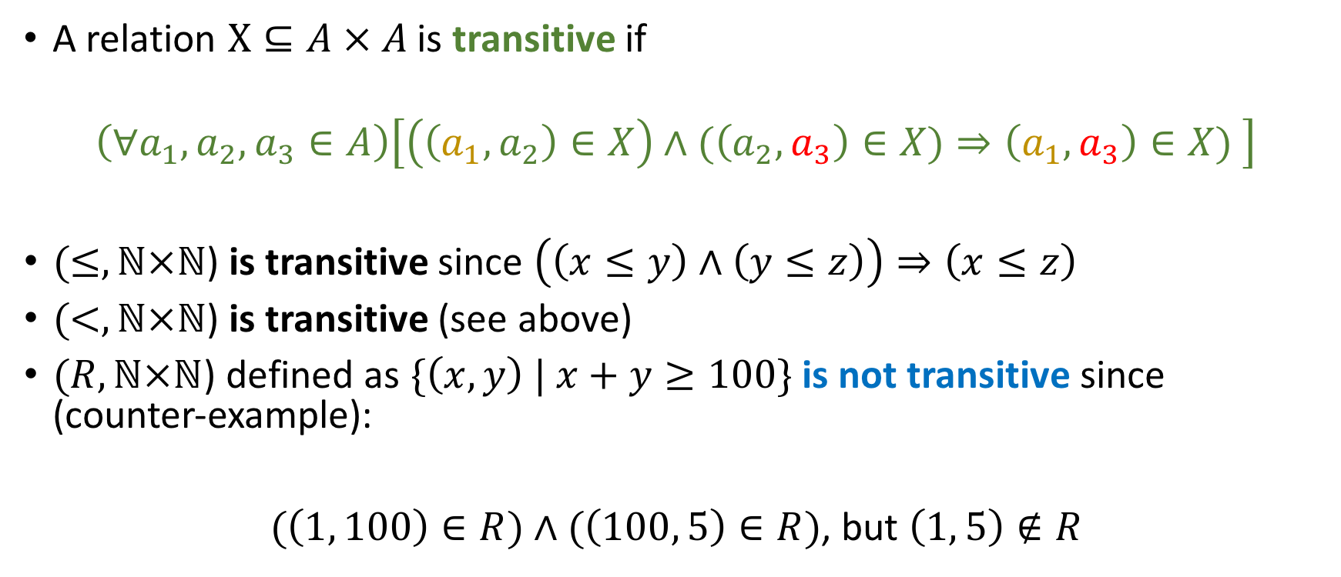
Transitivity
A relation $X⊆A × A$ is transitive if
$$\left(∀a_{1},a_{2}, a_{3}∈A\right)\left[\left(\left(a_{1}, a_{2}\right)∈X\right)∧(\left(a_{2},a_{3}\right)∈X)⇒\left(a_{1}, a_{3}\right)∈X) \right]$$
$(≤,ℕ×ℕ$) is transitive since $\left(\left(x≤y\right)∧\left(y≤z\right)\right)⇒\left(x≤z\right)$
$(<,ℕ×ℕ$) is transitive (see above)
$(R,ℕ×ℕ$) defined as $\{\left(x, y\right) | x+y≥100\}$ is not transitive since (counter-example):
$(\left(1, 100\right)∈R)∧(\left(100, 5\right)∈R)$, but $\left(1, 5\right)∉R$

Slide 14
Functions

Slide 15

Functions
Most basic representation: Arrow Diagrams
A
B
$$f$$

Slide 16
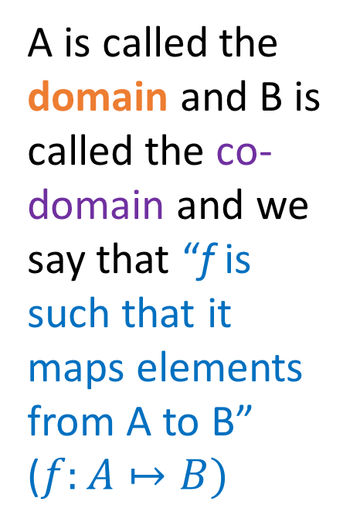
Functions
Most basic representation: Arrow Diagrams
A is called the domain and B is called the co-domain and we say that “f is such that it maps elements from A to B” ($f:A↦B)$
A
B
$$f$$
Notes:
Linger on this

Slide 17
Functions
Most basic representation: Arrow Diagrams
A is called the domain and B is called the co-domain and we say that “f is such that it maps elements from A to B” ($f:A↦B)$
A
B
$$f$$
\mapsto in LaTeX

Slide 18
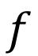
Example 1
Yes
No
Is this a function?
A
B
$$f$$
0 | 0
1 | 1
2 | 4
3
4

Slide 19
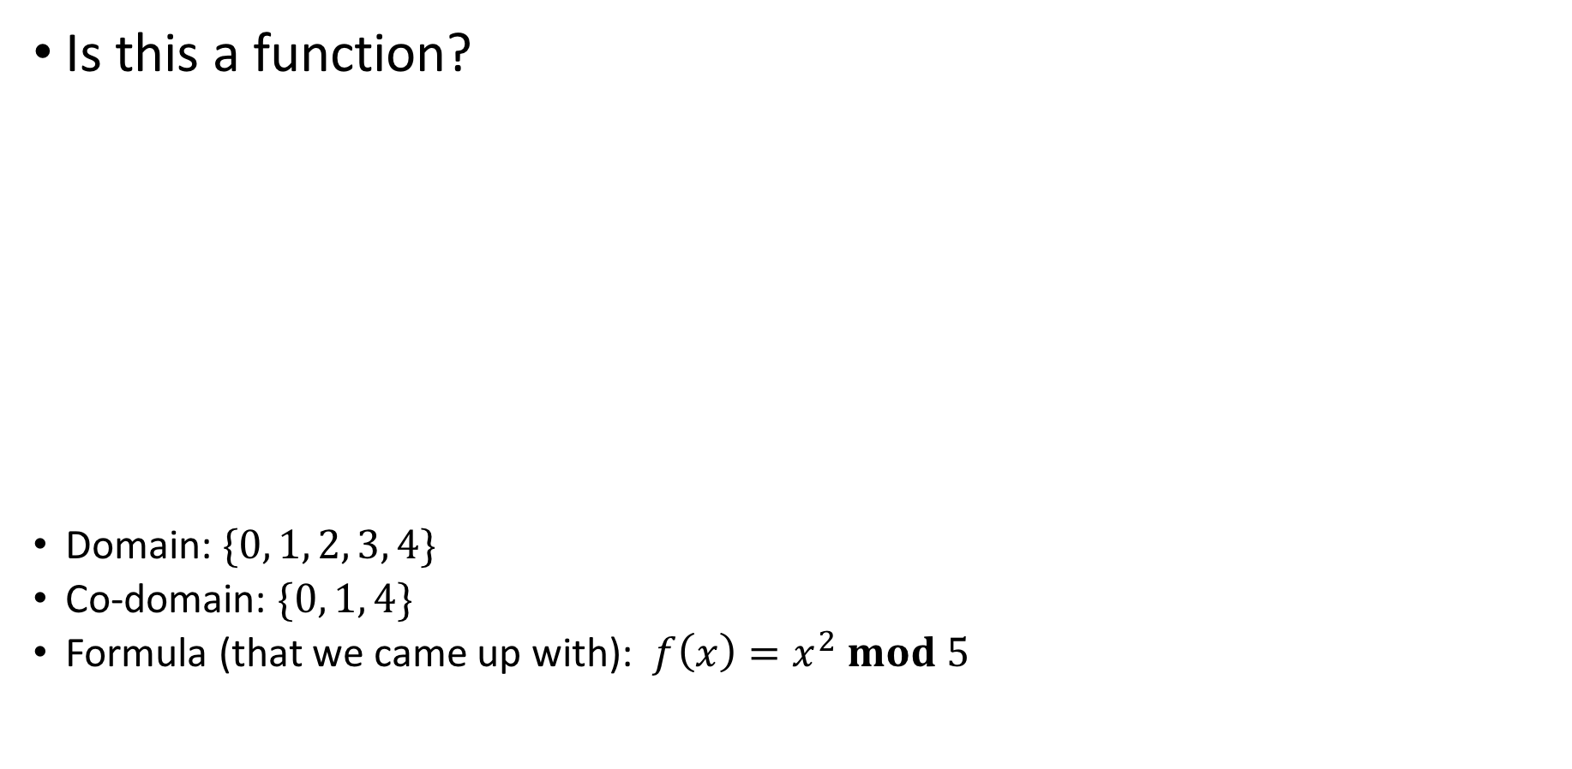
Example 1
Yes
No
Is this a function?
Domain: $\{0, 1, 2, 3, 4\}$
Co-domain: $\{0, 1, 4\}$
Formula (that we came up with): $f\left(x\right)=x^{2} mod 5$
A
B
$$f$$
0 | 0
1 | 1
2 | 4
3
4
Just because two ‘x’s map to the same ‘y’ doesn’t make this a non-function… it just makes it a non-injective (not “1-1”) function

Slide 20
Example 2
Yes
No
Is this a function?
A
B
0 | 0
1 | 1
2 | 4
3
4

Slide 21
Example 2
Yes
No
Is this a function?
Every element of the domain should map to some co-domain element!
A
B
0 | 0
1 | 1
2 | 4
3
4

Slide 22
Example 2
Yes
No
Is this a function?
A
B
0 | 0
1 | 1
2 | 4
3
4
7

Slide 23
Example 2
Yes
No
Is this a function?
A
B
Fails the “vertical line” test (2 different `y’s mapped to by the same `x’)
0 | 0
1 | 1
2 | 4
3
4
7

Slide 24
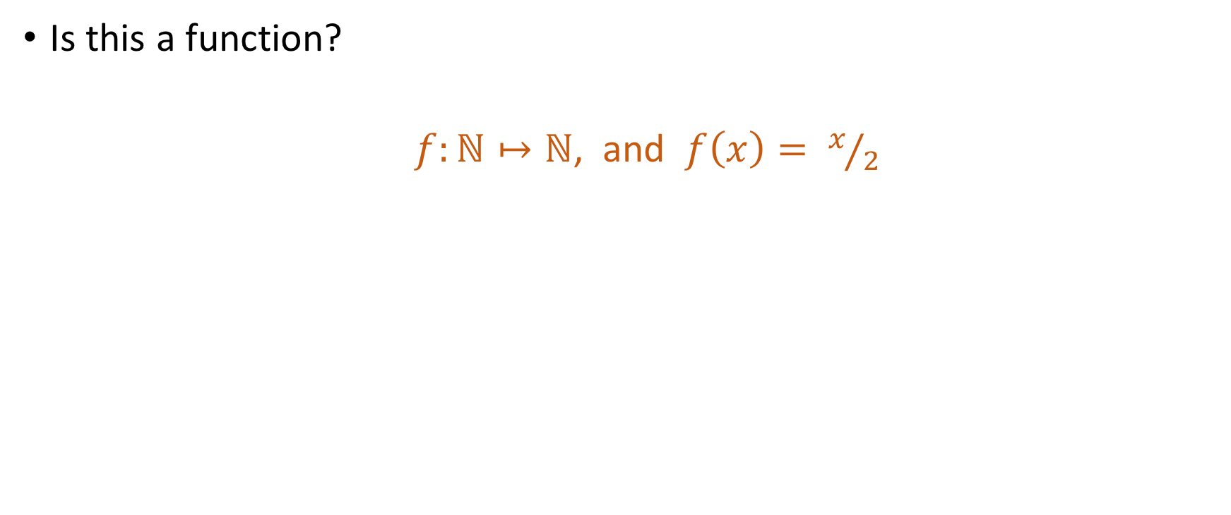
Example 3
Yes
No
Is this a function?
$f:ℕ↦ℕ$, and $f\left(x\right)= x/2$

Slide 25
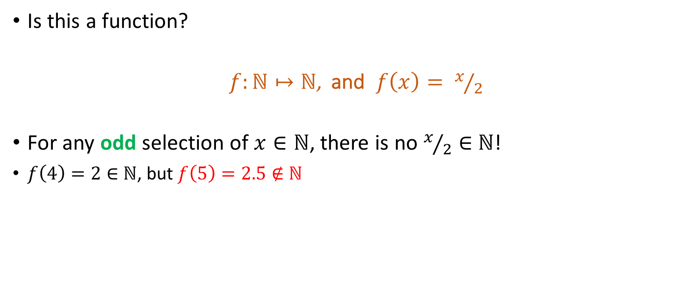
Example 3
Yes
No
Is this a function?
$f:ℕ↦ℕ$, and $f\left(x\right)= x/2$
For any odd selection of $x∈ℕ$, there is no $x/2∈$ $ℕ$!
$f\left(4\right)=2∈$ $ℕ$, but $f\left(5\right)=2.5∉$ $ℕ$

Slide 26
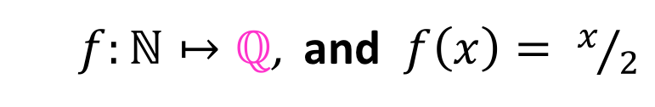
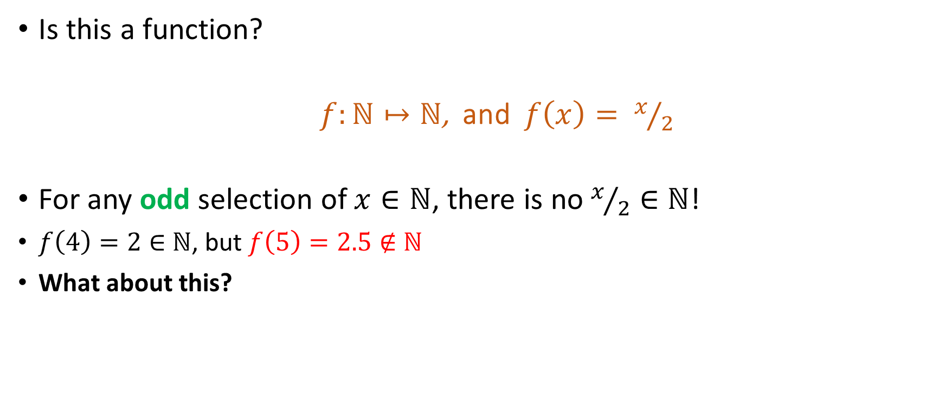
Example 3
Yes
No
Is this a function?
$f:ℕ↦ℕ$, and $f\left(x\right)= x/2$
For any odd selection of $x∈ℕ$, there is no $x/2∈$ $ℕ$!
$f\left(4\right)=2∈$ $ℕ$, but $f\left(5\right)=2.5∉$ $ℕ$
What about this?
$f:ℕ↦ℚ$, and $f\left(x\right)= x/2$

Slide 27
Example 3
Yes
No
Is this a function?
$f:ℕ↦ℕ$, and $f\left(x\right)= x/2$
For any odd selection of $x∈ℕ$, there is no $x/2∈$ $ℕ$!
$f\left(4\right)=2∈$ $ℕ$, but $f\left(5\right)=2.5∉$ $ℕ$
What about this?
$f:ℕ↦ℚ$, and $f\left(x\right)= x/2$

Slide 28
Example 4
Yes
No
Are the following valid functions?

Slide 29
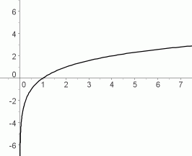
Example 4
Yes
No
Are the following valid functions?

Slide 30
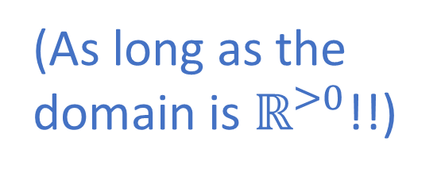
Example 4
Yes
No
(As long as the domain is $ℝ^{>0}$!!)
Log function

Slide 31
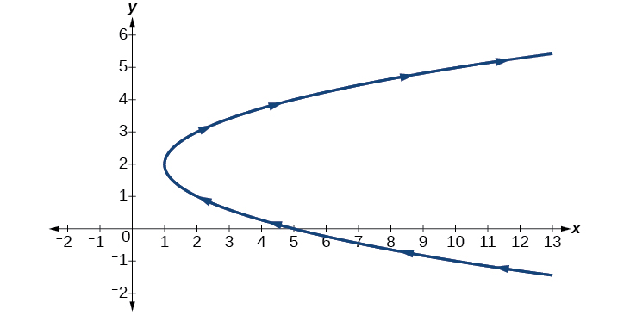
Example 5
Yes
No
Are the following valid functions?

Slide 32
Example 5
Yes
No
Are the following valid functions?
Fails the “vertical line” test

Slide 33
Example 5
Yes
No
Are the following valid functions?
A
B
$$f$$

Slide 34
Example 5
Yes
No
Are the following valid functions?
A
B
$$f$$
It just happens to
not be “1-1”

Slide 35
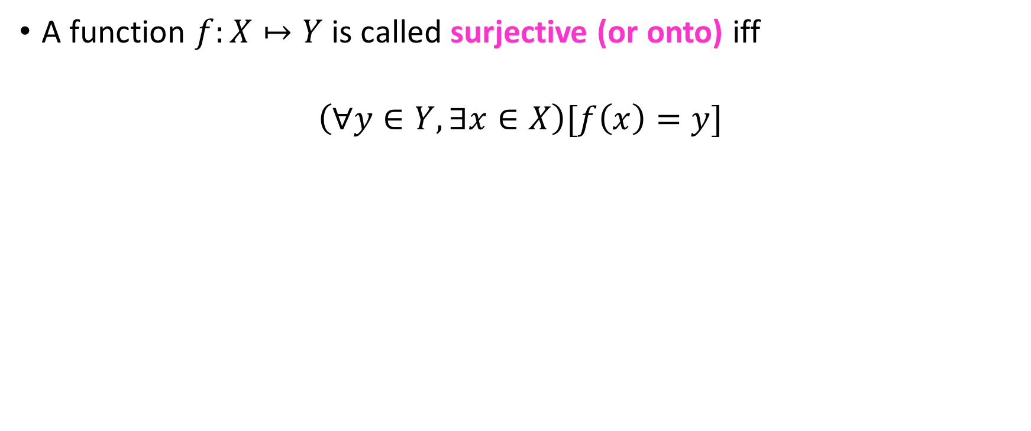
Surjective functions
A function $f:X↦Y$ is called surjective (or onto) iff
$$\left(∀y∈Y, ∃x∈X\right)[f\left(x\right)=y]$$

Slide 36
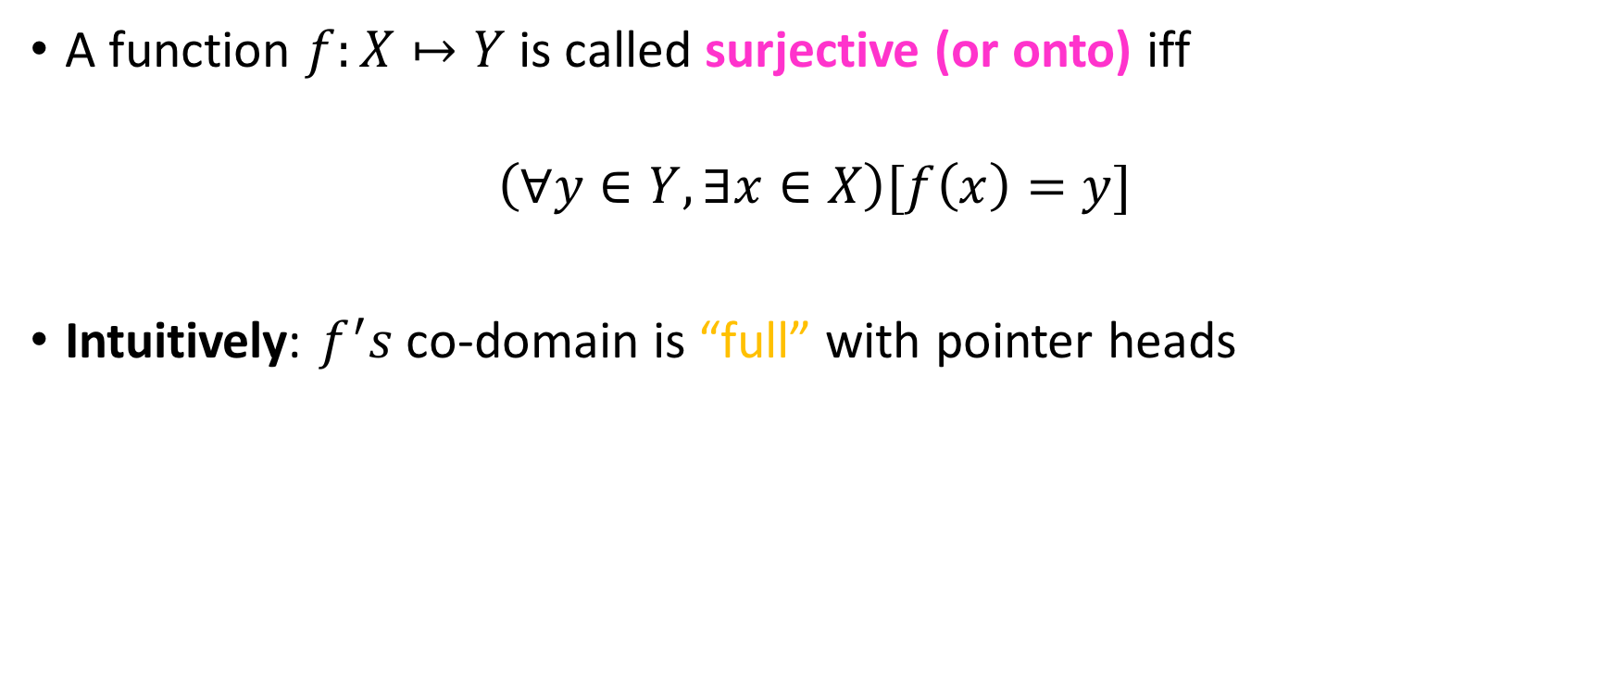
Surjective functions
A function $f:X↦Y$ is called surjective (or onto) iff
$$\left(∀y∈Y, ∃x∈X\right)[f\left(x\right)=y]$$
Intuitively: $f^{′}s$ co-domain is “full” with pointer heads

Slide 37
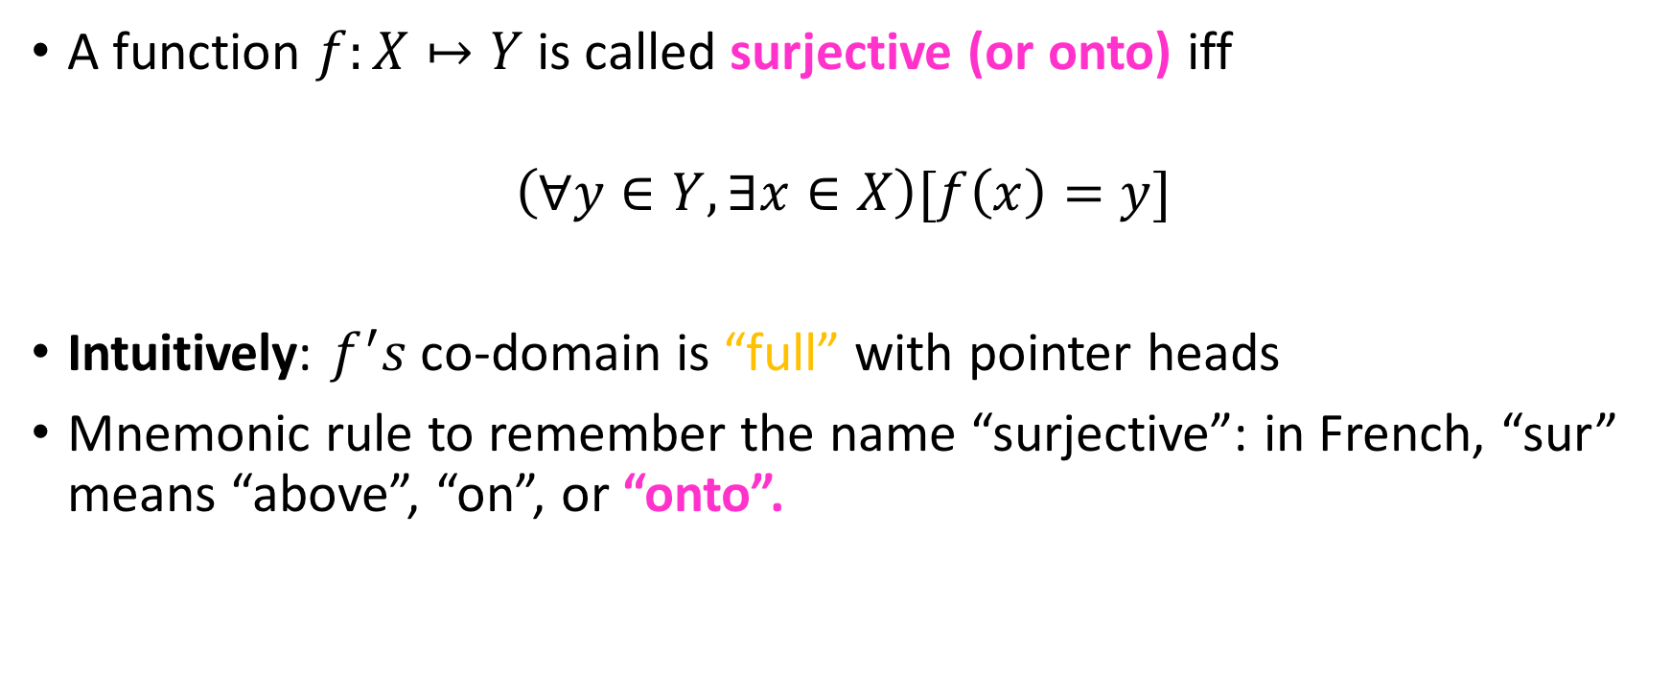
Surjective functions
A function $f:X↦Y$ is called surjective (or onto) iff
$$\left(∀y∈Y, ∃x∈X\right)[f\left(x\right)=y]$$
Intuitively: $f^{′}s$ co-domain is “full” with pointer heads
Mnemonic rule to remember the name “surjective”: in French, “sur” means “above”, “on”, or “onto”.

Slide 38
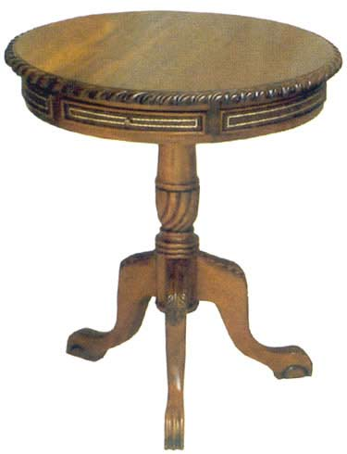
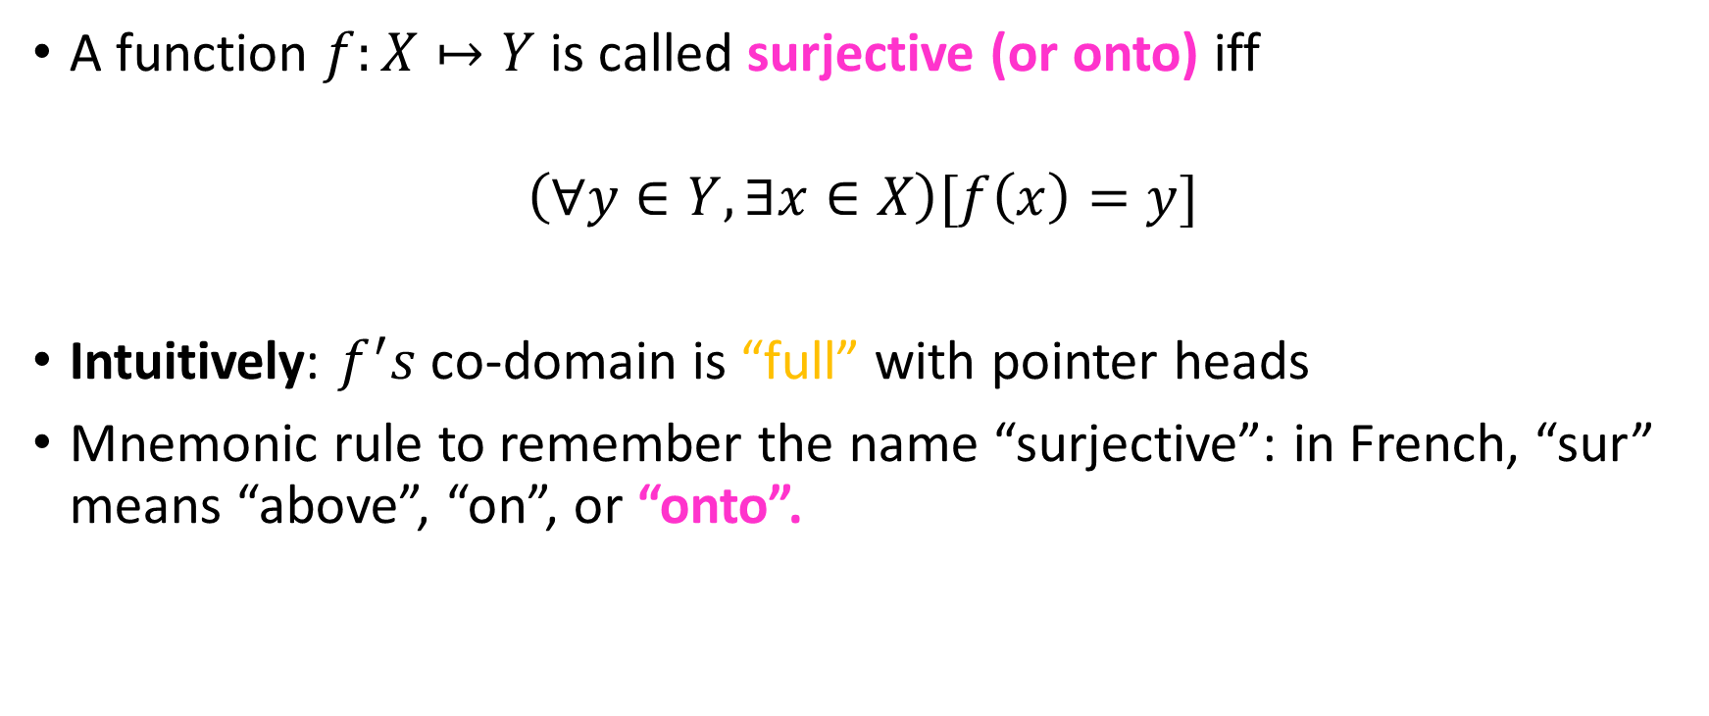
Surjective functions
A function $f:X↦Y$ is called surjective (or onto) iff
$$\left(∀y∈Y, ∃x∈X\right)[f\left(x\right)=y]$$
Intuitively: $f^{′}s$ co-domain is “full” with pointer heads
Mnemonic rule to remember the name “surjective”: in French, “sur” means “above”, “on”, or “onto”.
“sur”

Slide 39
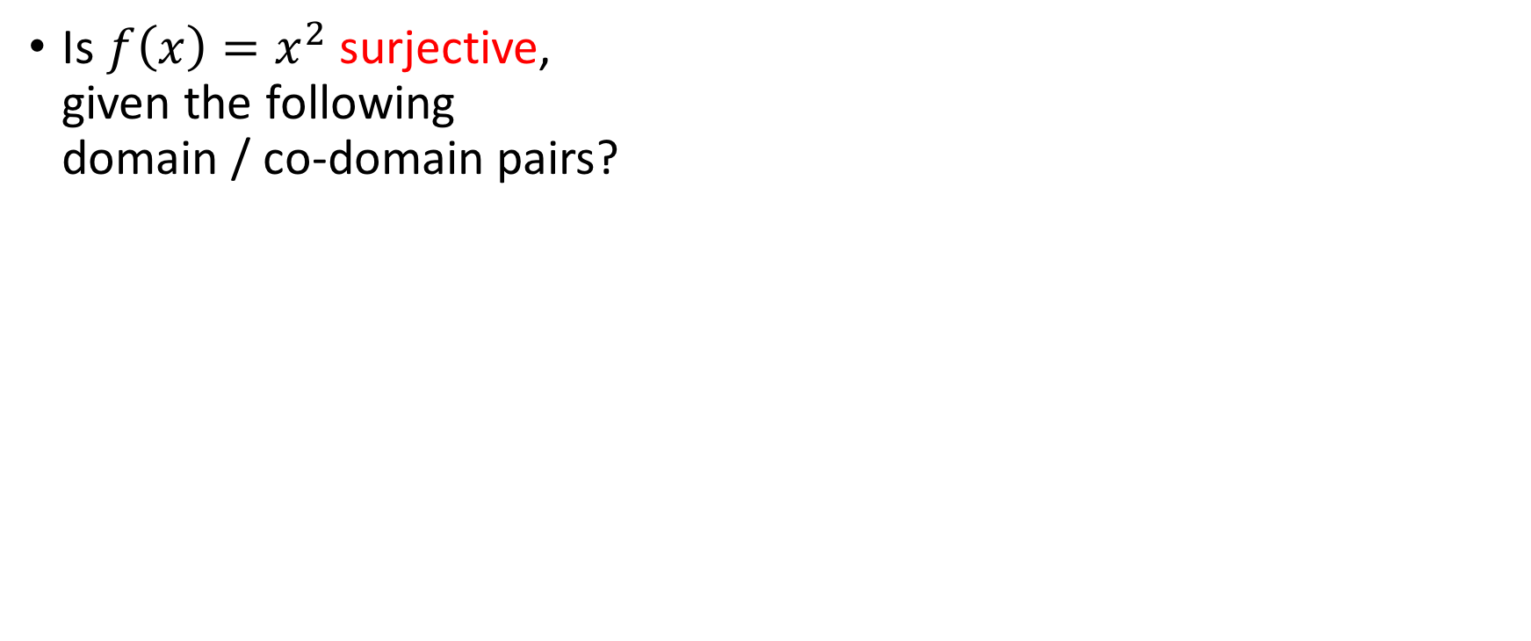
Quiz on surjectivity
Yes
No
Is $f\left(x\right)=x^{2}$ surjective, given the following domain / co-domain pairs?

Slide 40

Quiz on surjectivity
Yes
No
Is $f\left(x\right)=x^{2}$ surjective, given the following domain / co-domain pairs?
$D=ℝ, C=ℝ$

Slide 41
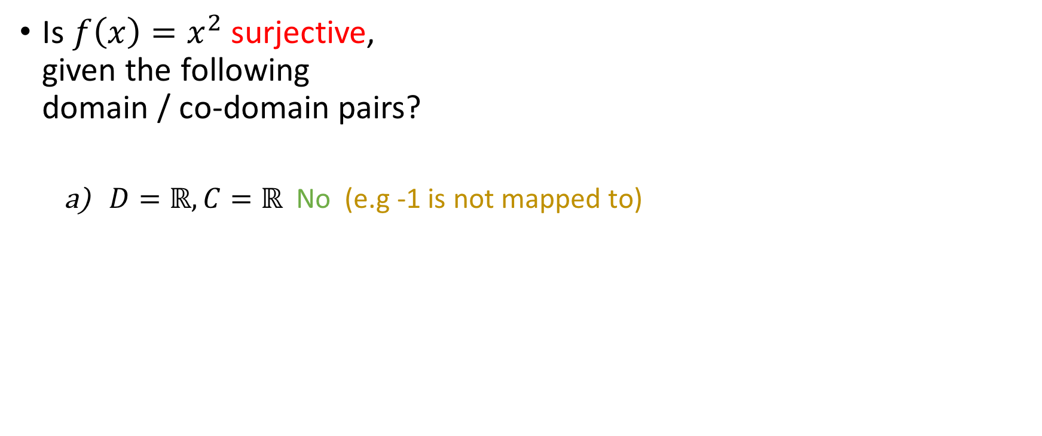
Quiz on surjectivity
Yes
No
Is $f\left(x\right)=x^{2}$ surjective, given the following domain / co-domain pairs?
$D=ℝ, C=ℝ$ No (e.g -1 is not mapped to)

Slide 42
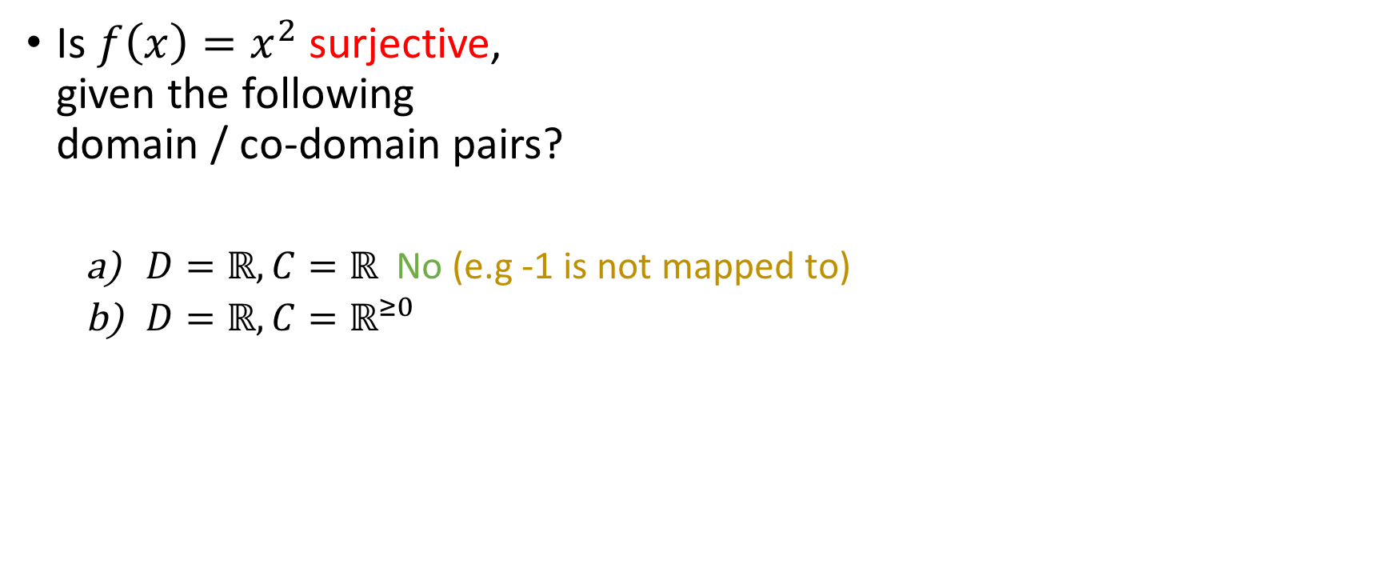
Quiz on surjectivity
Yes
No
Is $f\left(x\right)=x^{2}$ surjective, given the following domain / co-domain pairs?
$D=ℝ, C=ℝ$ No (e.g -1 is not mapped to)
$D=ℝ,C=ℝ^{≥0}$

Slide 43
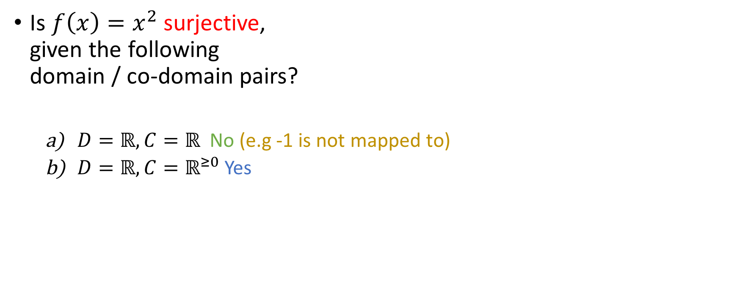
Quiz on surjectivity
Yes
No
Is $f\left(x\right)=x^{2}$ surjective, given the following domain / co-domain pairs?
$D=ℝ, C=ℝ$ No (e.g -1 is not mapped to)
$D=ℝ,C=ℝ^{≥0}$ Yes

Slide 44
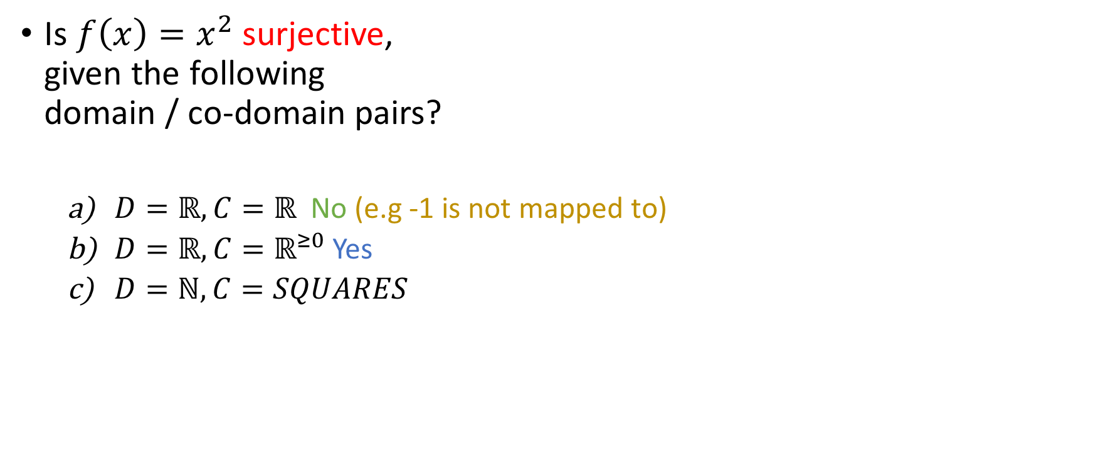
Quiz on surjectivity
Yes
No
Is $f\left(x\right)=x^{2}$ surjective, given the following domain / co-domain pairs?
$D=ℝ, C=ℝ$ No (e.g -1 is not mapped to)
$D=ℝ,C=ℝ^{≥0}$ Yes
$D=ℕ,C=SQUARES$

Slide 45
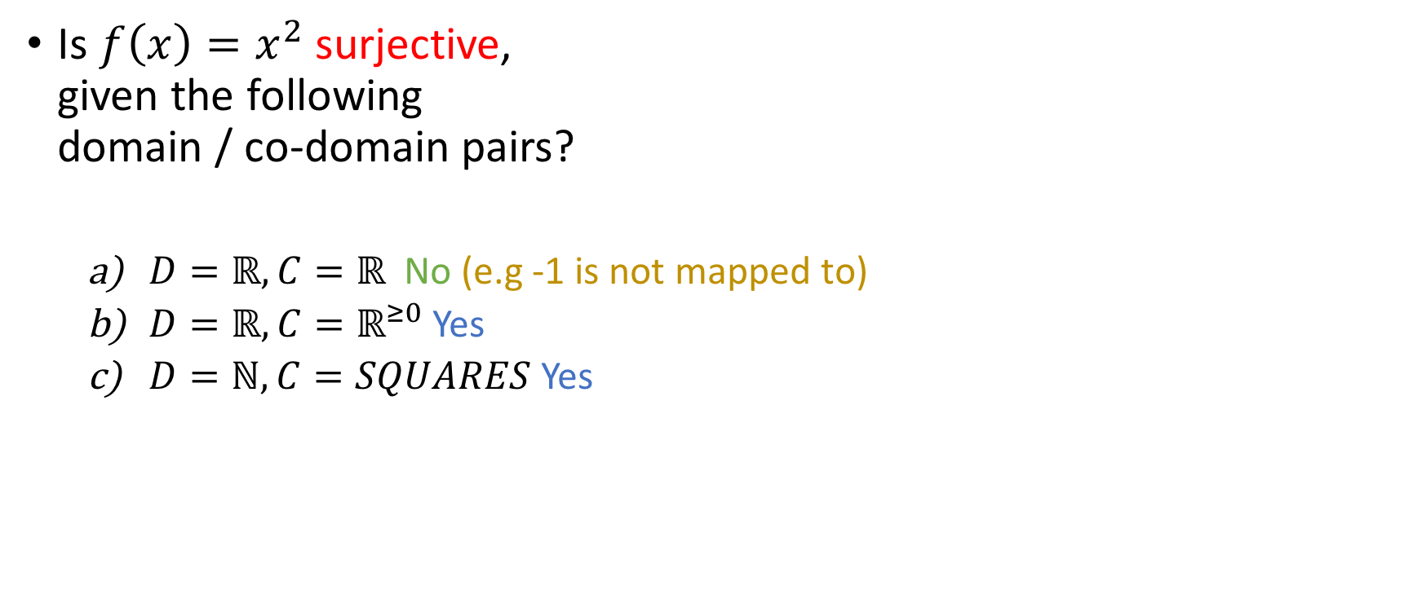
Quiz on surjectivity
Yes
No
Is $f\left(x\right)=x^{2}$ surjective, given the following domain / co-domain pairs?
$D=ℝ, C=ℝ$ No (e.g -1 is not mapped to)
$D=ℝ,C=ℝ^{≥0}$ Yes
$D=ℕ,C=SQUARES$ Yes

Slide 46
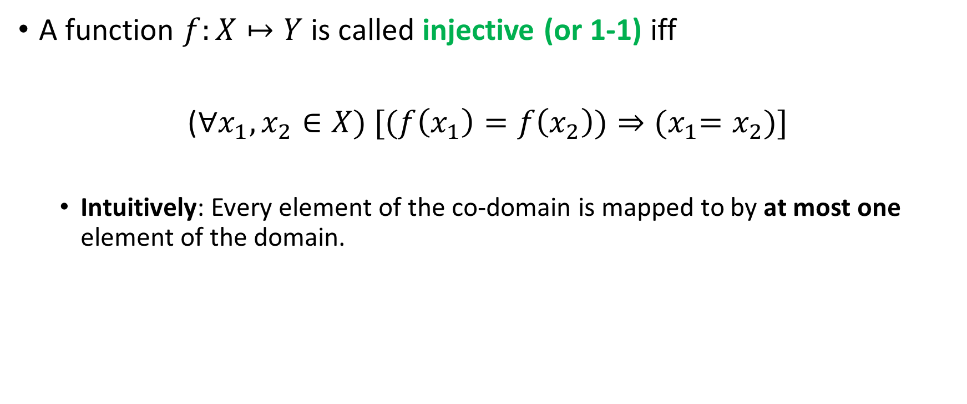
Injective functions
A function $f:X↦Y$ is called injective (or 1-1) iff
($∀x_{1},x_{2}∈X) [(f\left(x_{1}\right)=f\left(x_{2}\right))⇒{(x}_{1}=x_{2})]$
Intuitively: Every element of the co-domain is mapped to by at most one element of the domain.

Slide 47

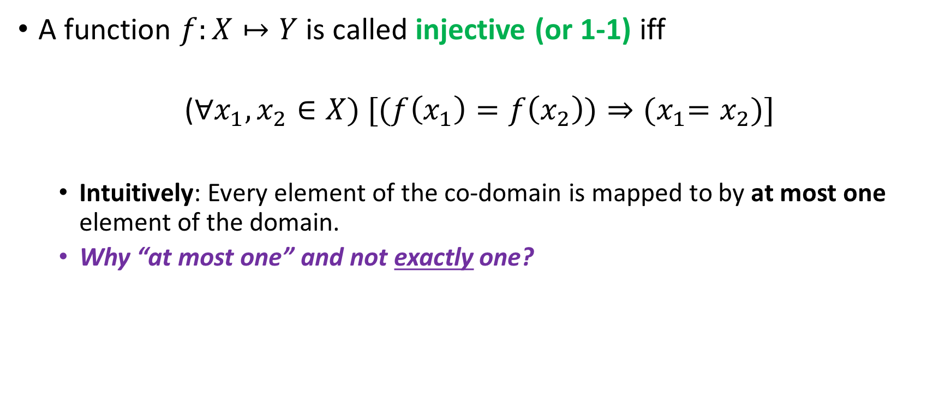
Injective functions
A function $f:X↦Y$ is called injective (or 1-1) iff
$$\text{(}∀x_{1},x_{2}∈X) [(f\left(x_{1}\right)=f\left(x_{2}\right))⇒{(x}_{1}=x_{2})]$$
Intuitively: Every element of the co-domain is mapped to by at most one element of the domain.
Why “at most one” and not exactly one?

Slide 48

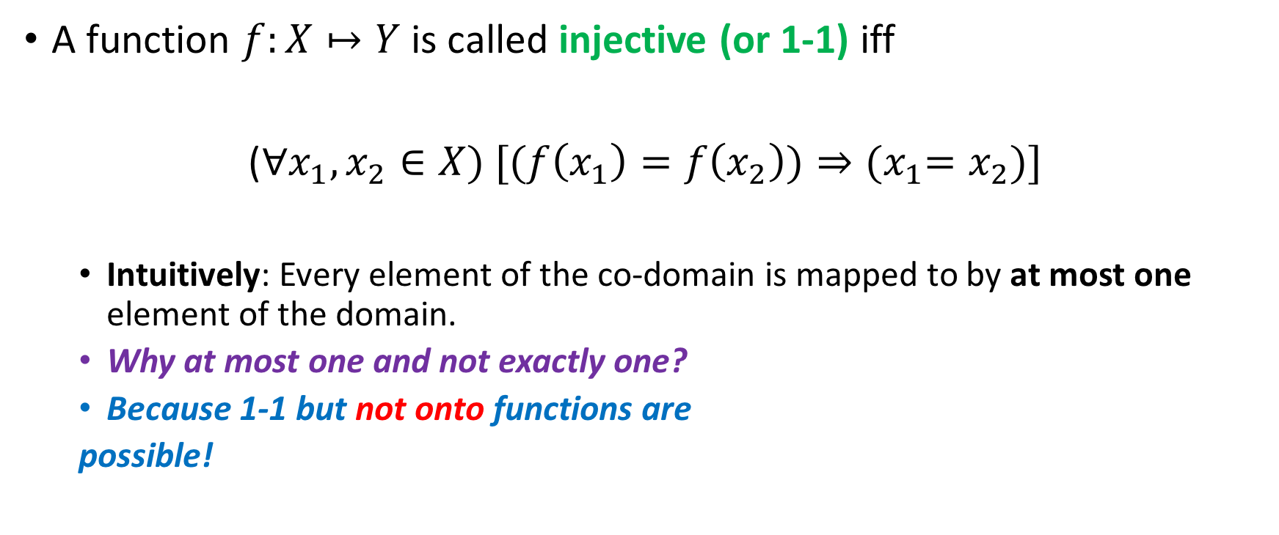

Injective functions
A function $f:X↦Y$ is called injective (or 1-1) iff
($∀x_{1},x_{2}∈X) [(f\left(x_{1}\right)=f\left(x_{2}\right))⇒{(x}_{1}=x_{2})]$
Intuitively: Every element of the co-domain is mapped to by at most one element of the domain.
Why at most one and not exactly one?
Because 1-1 but not onto functions are
possible!
X
$$f$$
Y

Slide 49

Quiz on injectivity
Is $f\left(x\right)=x^{2}$ injective, given the following domain / co-domain pairs?
Yes
No

Slide 50

Quiz on injectivity
Is $f\left(x\right)=x^{2}$ injective, given the following domain / co-domain pairs?
$D=ℝ, C=ℝ\text{:}$
Yes
No

Slide 51
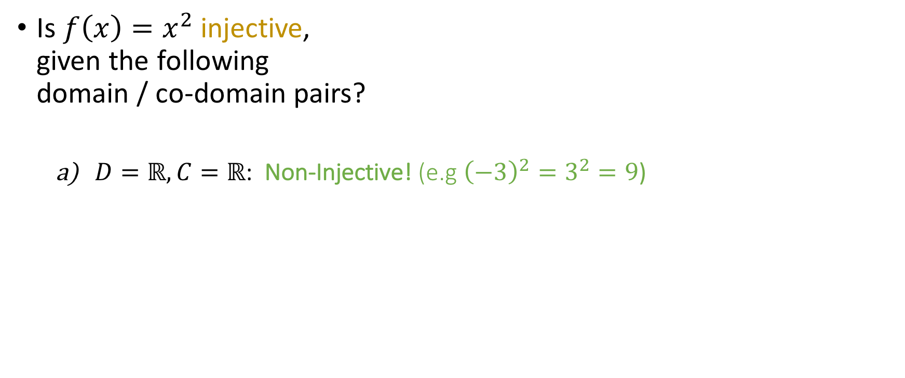
Quiz on injectivity
Is $f\left(x\right)=x^{2}$ injective, given the following domain / co-domain pairs?
$D=ℝ, C=ℝ\text{: }$Non-Injective! (e.g ${\left(−3\right)}^{2}=3^{2}=9$)
Yes
No

Slide 52
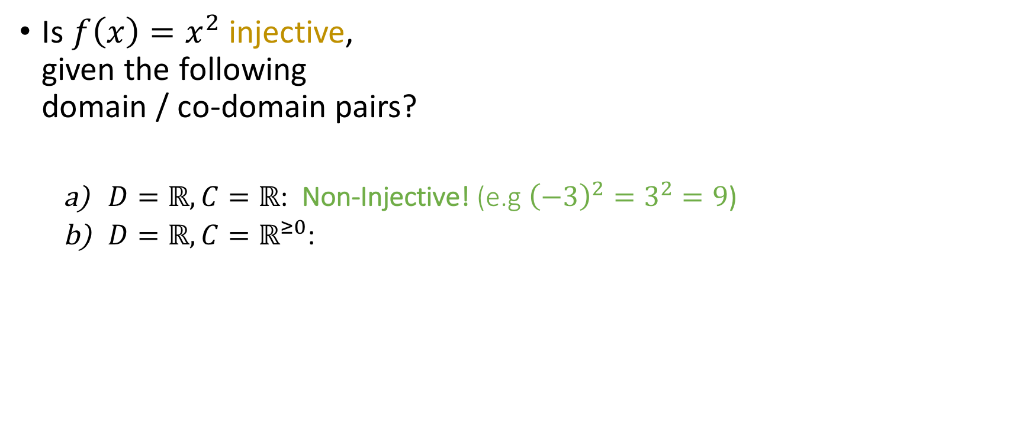
Quiz on injectivity
Is $f\left(x\right)=x^{2}$ injective, given the following domain / co-domain pairs?
$D=ℝ, C=ℝ\text{: }$Non-Injective! (e.g ${\left(−3\right)}^{2}=3^{2}=9$)
$D=ℝ,C=ℝ^{≥0}\text{:}$
Yes
No

Slide 53
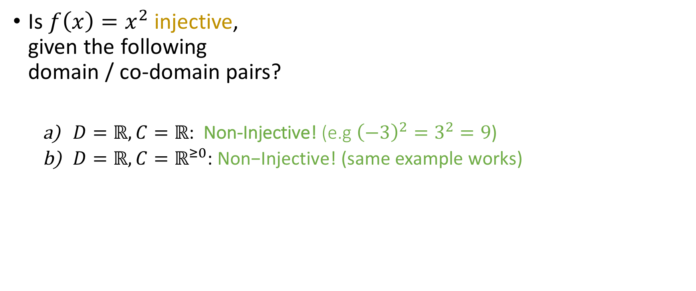
Quiz on injectivity
Is $f\left(x\right)=x^{2}$ injective, given the following domain / co-domain pairs?
$D=ℝ, C=ℝ\text{: }$Non-Injective! (e.g ${\left(−3\right)}^{2}=3^{2}=9$)
$D=ℝ,C=ℝ^{≥0}\text{:} \text{Non}\text{−}\text{Injective}\text{!}$ (same example works)
Yes
No

Slide 54
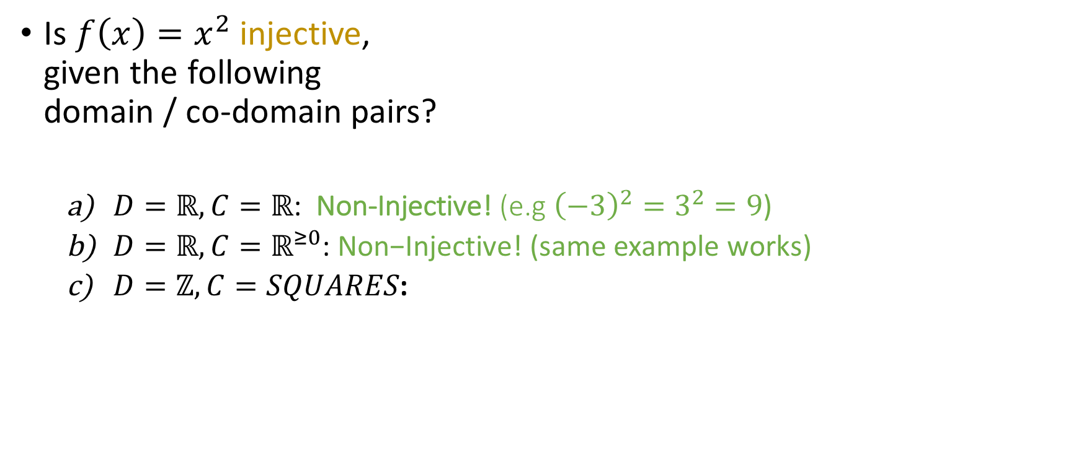
Quiz on injectivity
Is $f\left(x\right)=x^{2}$ injective, given the following domain / co-domain pairs?
$D=ℝ, C=ℝ\text{: }$Non-Injective! (e.g ${\left(−3\right)}^{2}=3^{2}=9$)
$D=ℝ,C=ℝ^{≥0}\text{:} \text{Non}\text{−}\text{Injective}\text{!}$ (same example works)
$D=ℤ,C=SQUARES\text{:}$
Yes
No

Slide 55
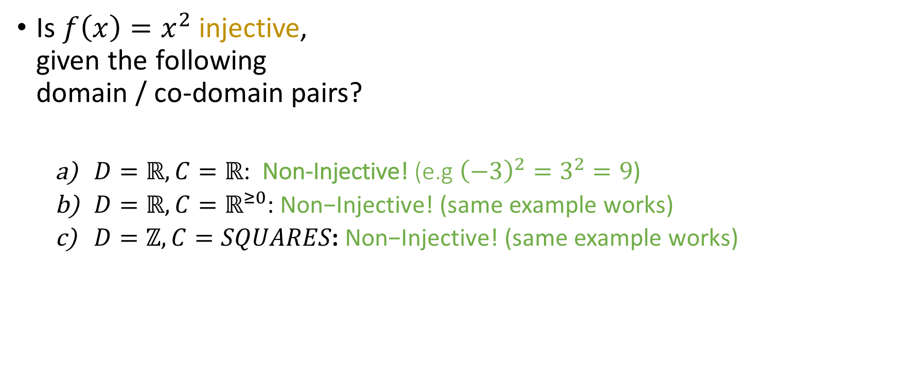
Quiz on injectivity
Is $f\left(x\right)=x^{2}$ injective, given the following domain / co-domain pairs?
$D=ℝ, C=ℝ\text{: }$Non-Injective! (e.g ${\left(−3\right)}^{2}=3^{2}=9$)
$D=ℝ,C=ℝ^{≥0}\text{:} \text{Non}\text{−}\text{Injective}\text{!}$ (same example works)
$D=ℤ,C=SQUARES\text{:} \text{Non}\text{−}\text{Injective}\text{!}$ (same example works)
Yes
No

Slide 56
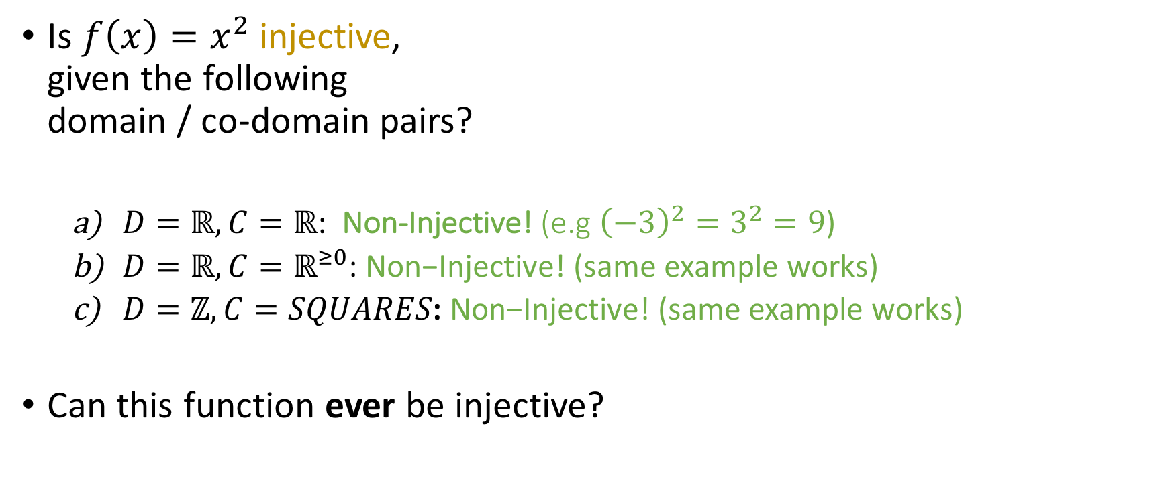
Quiz on injectivity
Is $f\left(x\right)=x^{2}$ injective, given the following domain / co-domain pairs?
$D=ℝ, C=ℝ\text{: }$Non-Injective! (e.g ${\left(−3\right)}^{2}=3^{2}=9$)
$D=ℝ,C=ℝ^{≥0}\text{:} \text{Non}\text{−}\text{Injective}\text{!}$ (same example works)
$D=ℤ,C=SQUARES\text{:} \text{Non}\text{−}\text{Injective}\text{!}$ (same example works)
Can this function ever be injective?
Yes
No

Slide 57
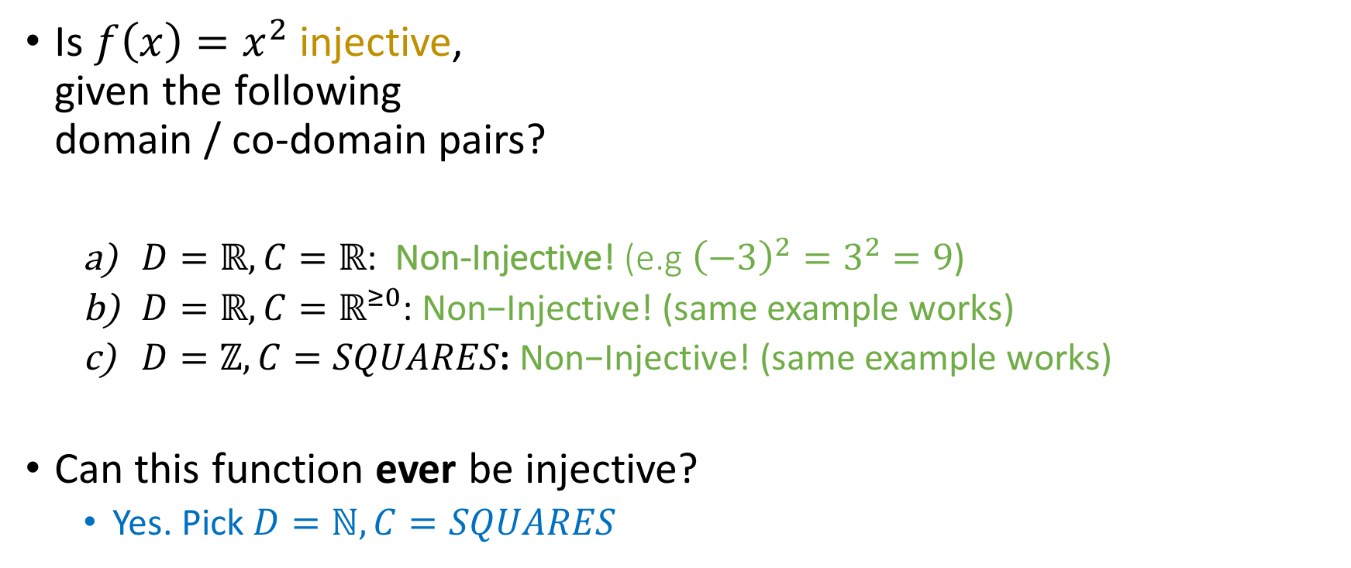
Quiz on injectivity
Is $f\left(x\right)=x^{2}$ injective, given the following domain / co-domain pairs?
$D=ℝ, C=ℝ\text{: }$Non-Injective! (e.g ${\left(−3\right)}^{2}=3^{2}=9$)
$D=ℝ,C=ℝ^{≥0}\text{:} \text{Non}\text{−}\text{Injective}\text{!}$ (same example works)
$D=ℤ,C=SQUARES\text{:} \text{Non}\text{−}\text{Injective}\text{!}$ (same example works)
Can this function ever be injective?
Yes. Pick $D=ℕ,C=SQUARES$
Yes
No

Slide 58
Making functions onto or 1-1
To make a function onto, we need to make the
co-domain smaller.
To make a function 1-1 , we need to make the
domain smaller.

Slide 59
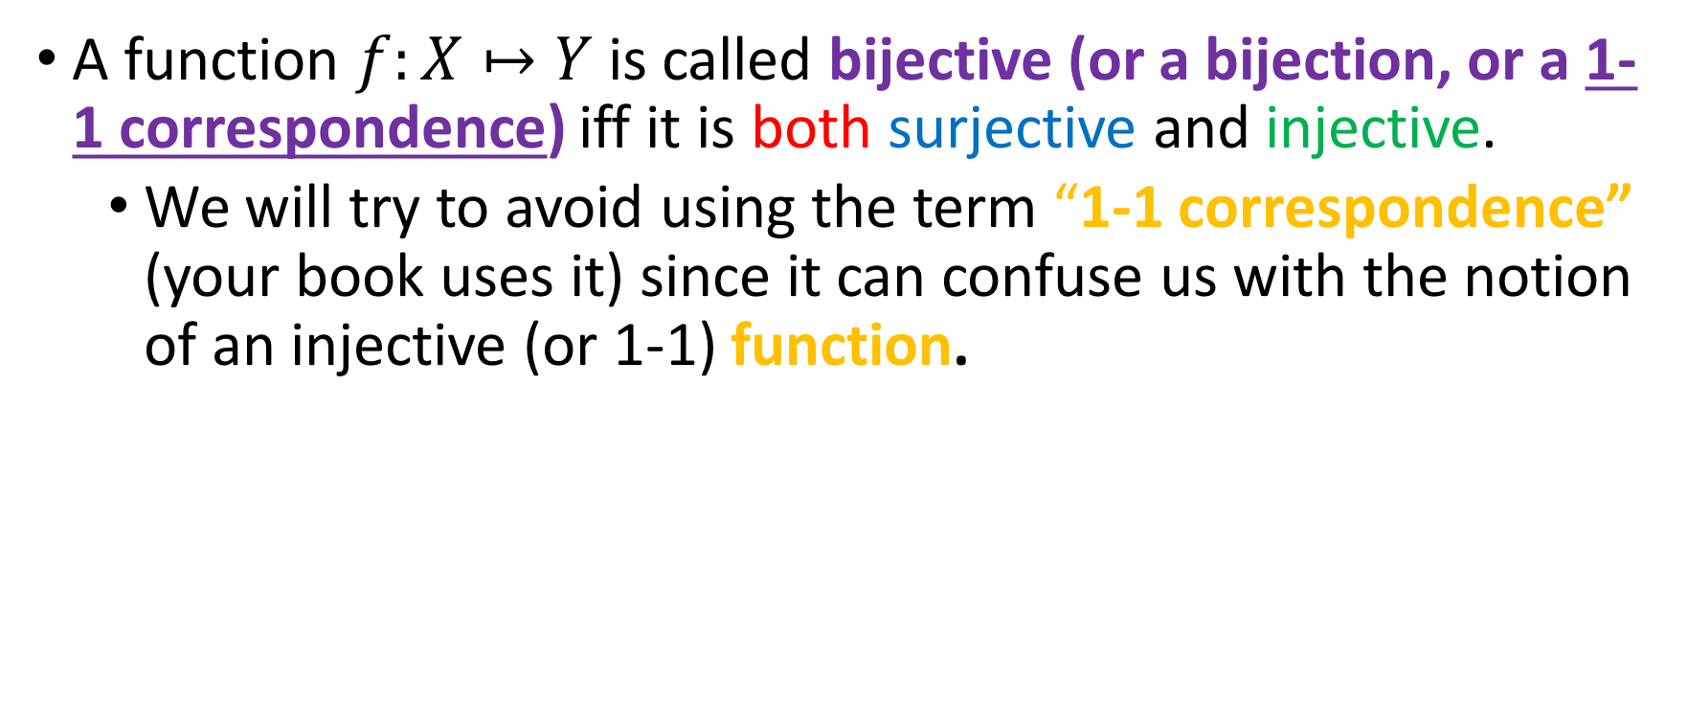
Bijective functions
A function $f:X↦Y$ is called bijective (or a bijection, or a 1-1 correspondence) iff it is both surjective and injective.
We will try to avoid using the term “1-1 correspondence” (your book uses it) since it can confuse us with the notion of an injective (or 1-1) function.

Slide 60
Quiz on bijections

Slide 61

Quiz on bijections
Yes
No
Are the following functions bijections?
(In all examples, $C=ℝ)$

Slide 62
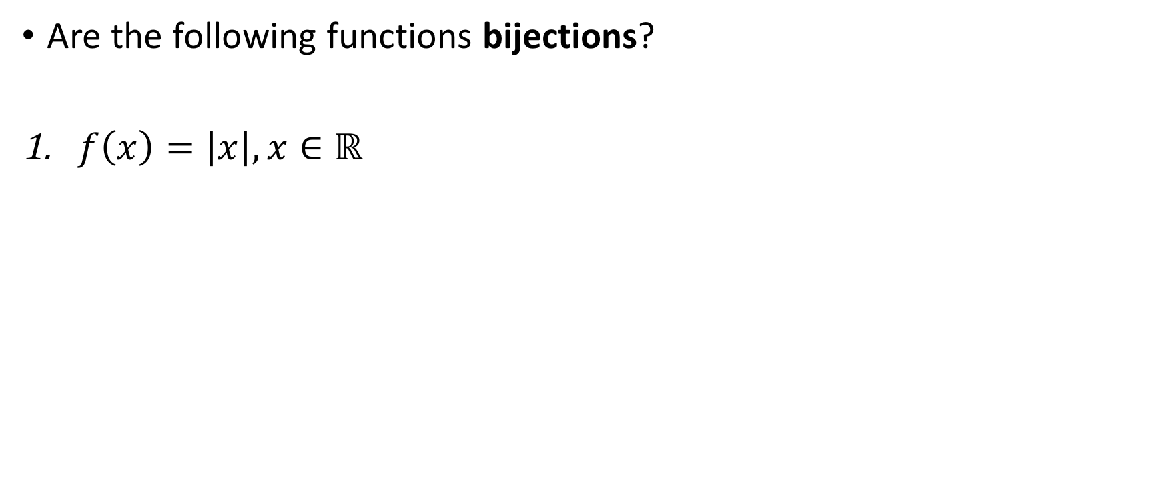
Quiz on bijections
Yes
No
Are the following functions bijections?
$f\left(x\right)=\left|x\right|, x∈ℝ$
(In all examples, $C=ℝ)$

Slide 63
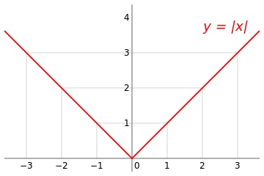
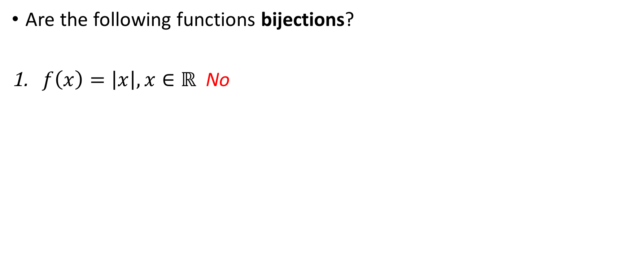
Quiz on bijections
Yes
No
Are the following functions bijections?
$f\left(x\right)=\left|x\right|, x∈ℝ$ No
(In all examples, $C=ℝ)$
Non-injective!

Slide 64
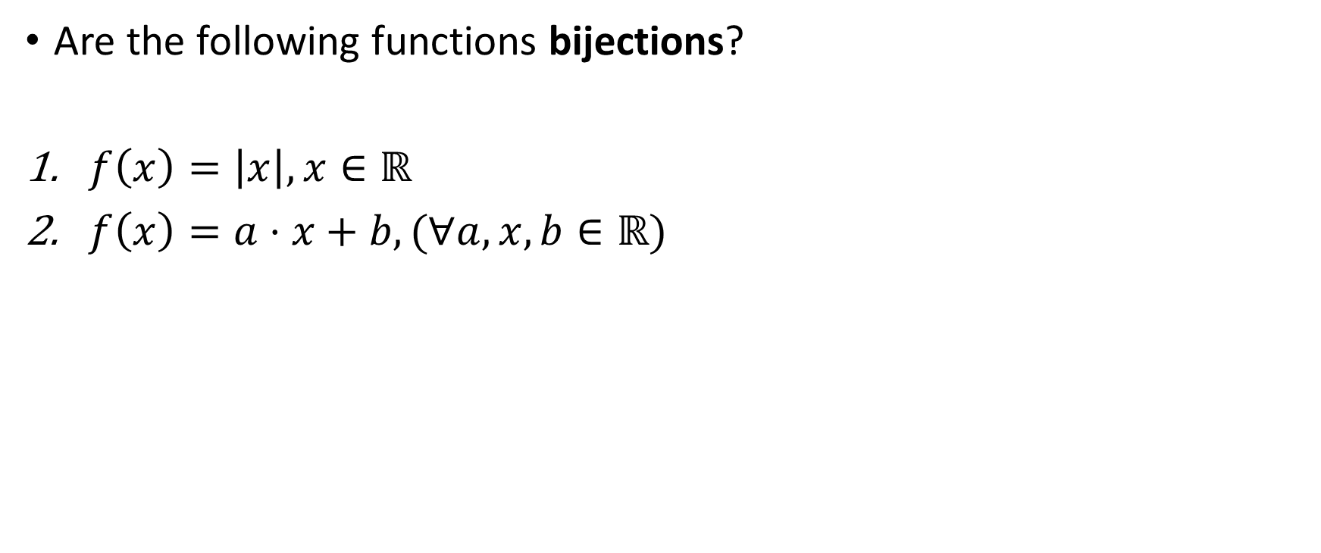
Quiz on bijections
Yes
No
Are the following functions bijections?
$f\left(x\right)=\left|x\right|, x∈ℝ$
$f\left(x\right)=a⋅x+b,(∀a,x,b∈ℝ)$
(In all examples, $C=ℝ)$

Slide 65
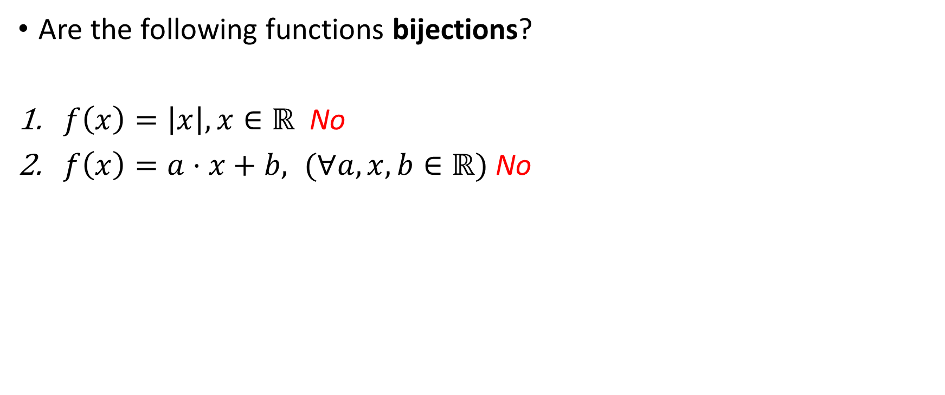
Quiz on bijections
Yes
No
Are the following functions bijections?
$f\left(x\right)=\left|x\right|, x∈ℝ$ No
$f\left(x\right)=a⋅x+b, (∀a,x,b∈ℝ)$ No
(In all examples, $C=ℝ)$
!!!!
For a = 0, the graph of the function fails the “horizontal line test”!

Slide 66
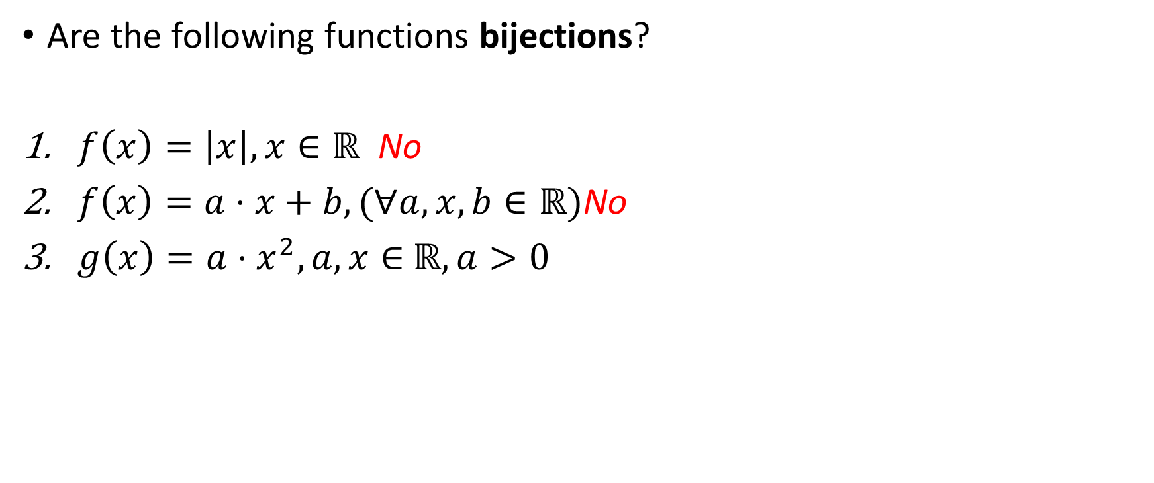
Quiz on bijections
Yes
No
Are the following functions bijections?
$f\left(x\right)=\left|x\right|, x∈ℝ$ No
$f\left(x\right)=a⋅x+b,(∀a,x,b∈ℝ)$No
$g\left(x\right)={a⋅x}^{2}, a,x∈$ $ℝ, a>0$
(In all examples, $C=ℝ)$

Slide 67
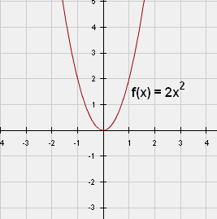

Quiz on bijections
Yes
No
Are the following functions bijections?
$f\left(x\right)=\left|x\right|, x∈ℝ$ No
$f\left(x\right)=a⋅x+b,(∀a,x,b∈ℝ)$No
$g\left(x\right)={a⋅x}^{2}, a,x∈$ $ℝ, a>0$ No
(In all examples, $C=ℝ)$
Non-injective!

Slide 68

Quiz on bijections
Yes
No
Are the following functions bijections?
$f\left(x\right)=\left|x\right|, x∈ℝ$ No
$f\left(x\right)=a⋅x+b,(∀a,x,b∈ℝ)$No
$g\left(x\right)={a⋅x}^{2}, a,x∈$ $ℝ, a>0$ No
$h\left(n\right)=4n −1, n∈ℤ$
(In all examples, $C=ℝ)$

Slide 69


Quiz on bijections
Yes
No
Are the following functions bijections?
$f\left(x\right)=\left|x\right|, x∈ℝ$ No
$f\left(x\right)=a⋅x+b,(∀a,x,b∈ℝ)$No
$g\left(x\right)={a⋅x}^{2}, a,x∈$ $ℝ, a>0$ No
$h\left(n\right)=4n −1, n∈ℤ$ No
(In all examples, $C=ℝ)$
Non-surjective! Set $h\left(n\right)=y$ and solve for $n$:
$$4n – 1 = y⇒n= \frac{y+1}{4}$$
There are infinitely many choices of $y$ for which $n∉ℤ$!

Slide 70

Quiz on bijections
Yes
No
Are the following functions bijections?
$f\left(x\right)=\left|x\right|, x∈ℝ$ No
$f\left(x\right)=a⋅x+b,(∀a,x,b∈ℝ)$No
$g\left(x\right)={a⋅x}^{2}, a,x∈$ $ℝ, a>0$ No
$h\left(n\right)=4n −1, n∈ℤ$ No
$h\left(x\right)=4x −1, x∈ℝ$
(In all examples, $C=ℝ)$

Slide 71


Quiz on bijections
Yes
No
Are the following functions bijections?
$f\left(x\right)=\left|x\right|, x∈ℝ$ No
$f\left(x\right)=a⋅x+b,(∀a,x,b∈ℝ)$No
$g\left(x\right)={a⋅x}^{2}, a,x∈$ $ℝ, a>0$ No
$h\left(n\right)=4n −1, n∈ℤ$ No
$h\left(x\right)=4x −1, x∈ℝ$ Yes
(In all examples, $C=ℝ)$
Surjective and injective! Surjective, since, if we set $h\left(n\right)=y$ and solve for $n$:
$$4n – 1 = y⇒n= \frac{y+1}{4}$$
For every real $y$, there’s always a real solution $n.$ Injective, since it’s of the form of (2) with $a≠0$.

Slide 72
Some special functions
Are the following Java functions injective, surjective, bijective?
Comparable.compareTo()
Object.hashCode()

